Slide 1
UKMO CET (monthly avges)
1974-2012

Slide 2
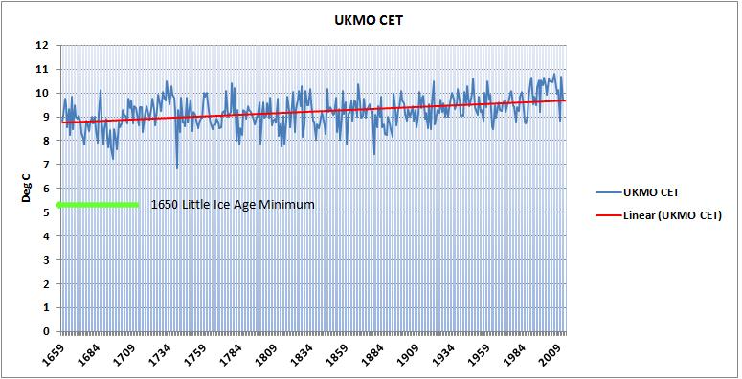
Central England Temperature
CET 1659-2012
- Trend shows natural recovery from Little Ice Age
0.87 deg C in 353 years [0.025 deg C/decade]

Slide 3
CET FACTS
 |  | CET 1659-2012 Analysis
 | Date | Deg C | No Years | Deg C | Equivalent
Highest | 2006 | 10.82
Lowest | 1740 | 6.84 |  | 0.015 | per decade
 |  | Diff 3.98 | 266 | 0.15 | per century
Biggest | 1739 | 9.20
Variation | 1740 | 6.84 |  | -23.60 | per decade
 | 1741 | 9.30 |  | 24.60 | per decade
Start | 1659 | 8.83
End | 2012 | 9.70 | 353 | 0.025 | per decade
Diff |  | 0.87 |  | 0.25 | per century
O Mt Tarumae volcanic eruption 1739
O Natural Variation – life survived
O Not catastrophic in the slightest

Slide 4
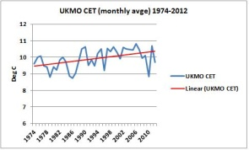
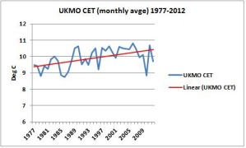
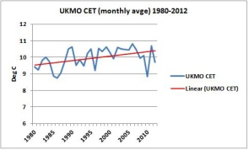
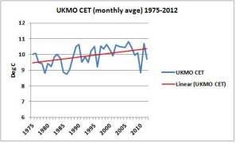
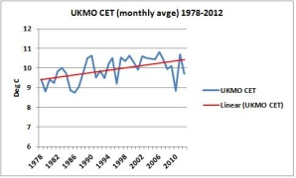
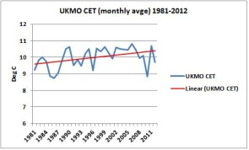
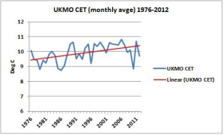
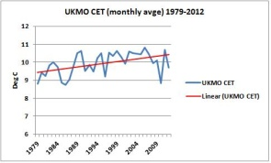
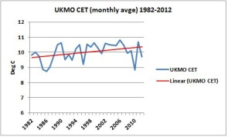
UKMO CET 1974/1982-2012
1974/5/6-2012
1977/8/9-2012
1980/1/2-2012
Going up

Slide 5
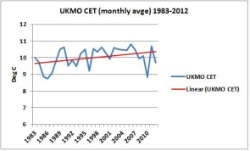
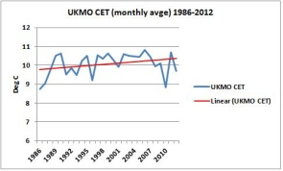
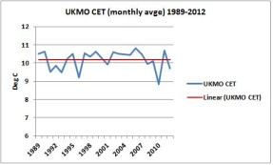
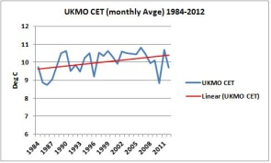
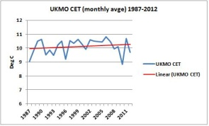
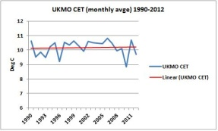
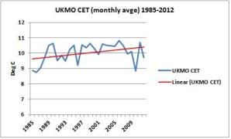
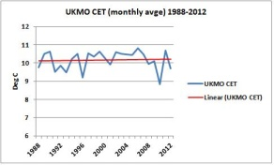
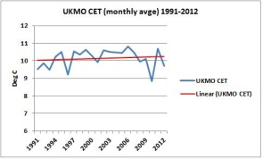
UKMO CET 1983/1991-2012
1983/4/5-2012
1986/7/8-2012
1989/1990/1-2012
Levelling off

Slide 6
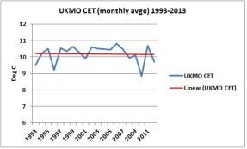
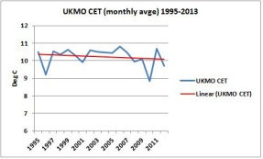
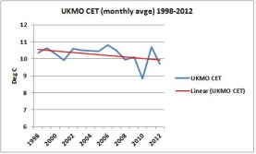
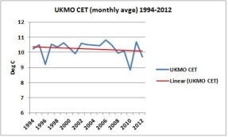
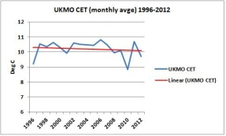
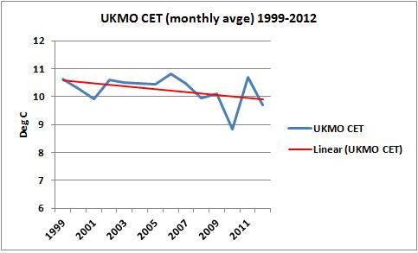
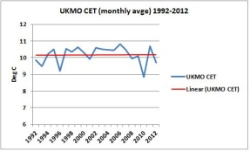
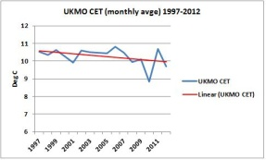
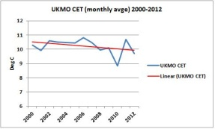
UKMO CET 1992/2000-2012
1992/3/4-2012
1995/6/7-2012
1998/9/2000-2012
Going down

Slide 7
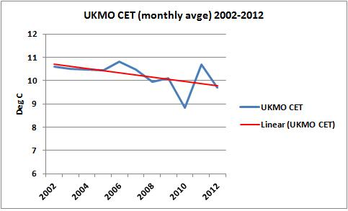
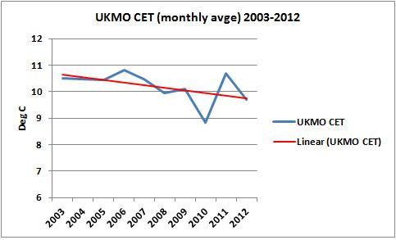
UKMO CET 2001/2003-2012
Temperature trend in the UK has been cooling since 1992 20 years

Slide 8
CET Raw Data
Date | CET Monthly Avges
1974 | 9.62
1975 | 10.00
1976 | 10.08
1977 | 9.48
1978 | 9.42
1979 | 8.81
1980 | 9.42
1981 | 9.24
1982 | 9.84
1983 | 10.03
1984 | 9.73
1985 | 8.86
1986 | 8.74
1987 | 9.05
1988 | 9.77
1989 | 10.50
1990 | 10.63
1991 | 9.52
1992 | 9.86
1993 | 9.49
1994 | 10.24
1995 | 10.52
1996 | 9.20
1997 | 10.53
1998 | 10.34
1999 | 10.63
2000 | 10.30
2001 | 9.93
2002 | 10.60
2003 | 10.50
2004 | 10.48
2005 | 10.44
2006 | 10.82
2007 | 10.48
2008 | 9.96
2009 | 10.11
2010 | 8.83
2011 | 10.70
2012 | 9.70
http://www.metoffice.gov.uk/hadobs/hadcet/

